Slide 1
Free tier aws acc creation
by Chethan Kolakanti

Slide 2
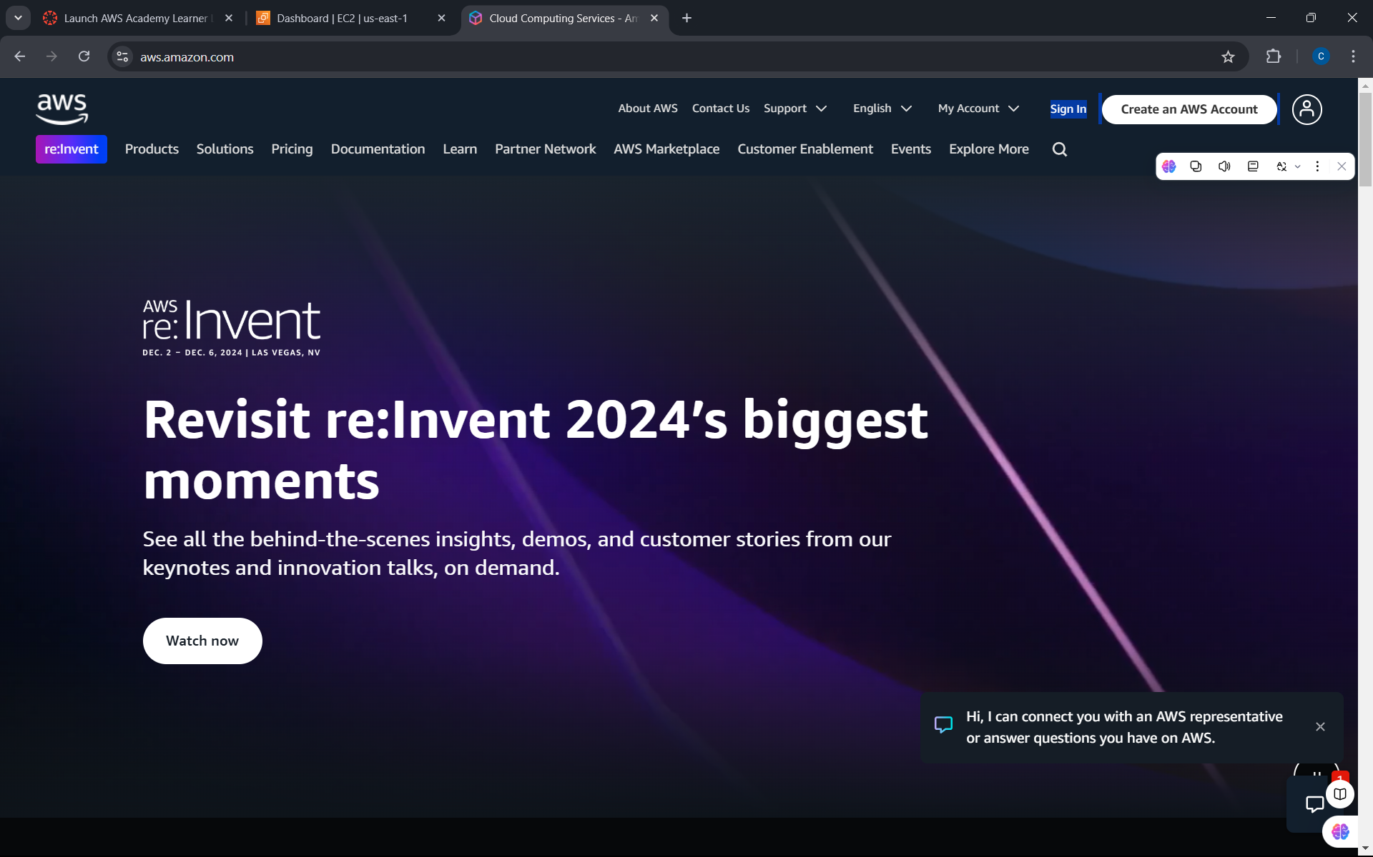
- Click on create an aws account

Slide 3
